Slide 1
GPT models: a talk on opportunities, pitfalls, lessons learned. also: fish!
genomic.social/@PhilippBayer
22nd June 2023

Slide 2
Disclaimers first
This will be a relatively opinionated talk; today’s opinions may not necessarily overlap with opinions and positions of my employer(s)
OceanOmics

Slide 3
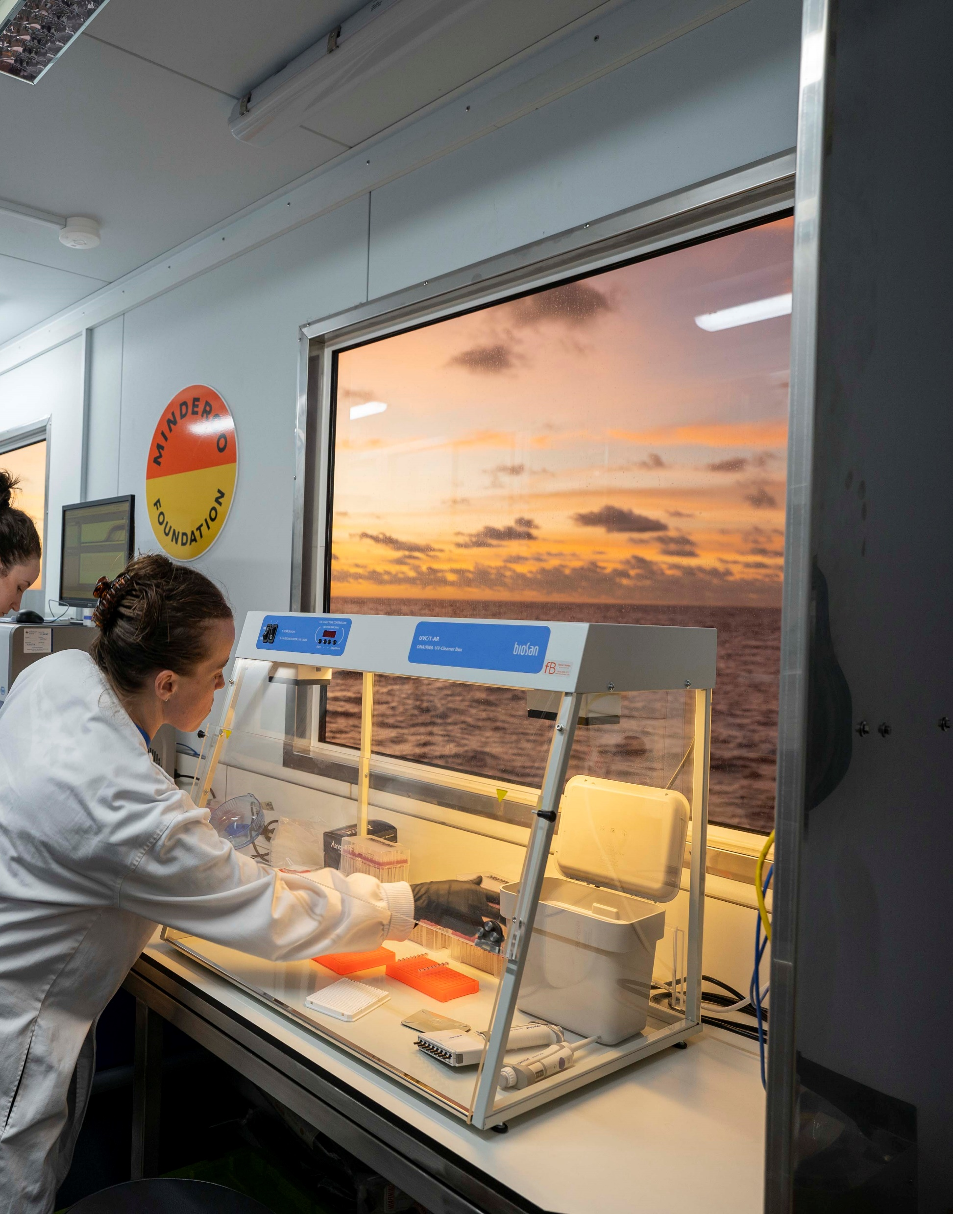







Revolutionising how we measure, understand and conserve life in the ocean
eDNA Innovation
Computational Biology
Reference Genomes
Scaling at Sea
Sustainable Fisheries
Biodiversity Conservation
Ecology and MPA Management
Blue Finance and Valuing Nature

Slide 4
What I do at Minderoo oceanomics
We sequence DNA in sea water samples ‘left’ by fish. The goal: a scalable method to observer which fish species live where, ultimately which fish individuals live where.
The ultimate purpose: by knowing which species live where, we can have a voice in how marine protected areas are established by governments.
Needle in a haystack problem, only little fish DNA in the sample (>99% bacterial/viral); only few fish genomes are sequenced (3-4%)
OceanOmics

Slide 5
What I do at Minderoo oceanomics
One project I started is using LLMs/GPTs to make sense of our data to help ‘regular’ people interact with our results.
We generate large amounts of DNA data and DNA-based fish sightings data. Big problem: You need some R or Python skills to ask your own questions of that data. We write papers but a paper is only one possible ‘story’ the data could tell.
But: what if we could use ChatGPT to interact with that data? A marine park manager asks, and the answer helps in establishing marine protection guidelines?
OceanOmics

Slide 6
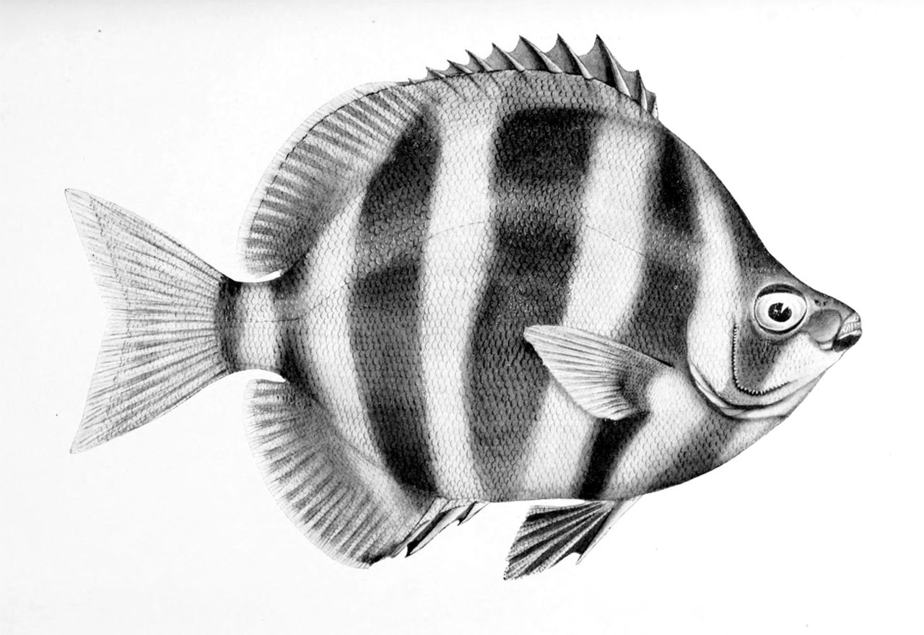
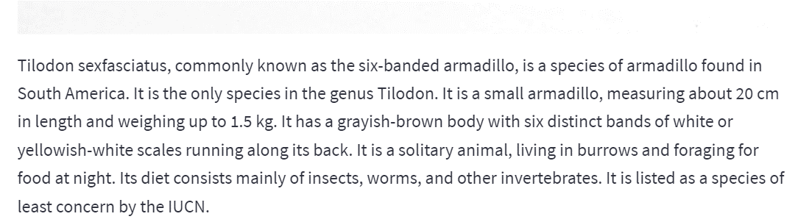
Early failures
If another tool detects a species, can we ask ChatGPT to describe that species? GPT 3.5 on Tilodon sexfasciatus!
OceanOmics

Slide 7
Early failures
Far more problematic: ‘OK’ results that are NOT 100% correct. Very hard to spot for regular users; even fish scientists take a while. Some details wrong, but not overall story.
The text would often read something like:
Fish X is within the family Y (correct) living in large schools of up to 1000 fish (correct). It is a strict herbivore (INCORRECT). It has complex social structures (correct).
OceanOmics

Slide 8
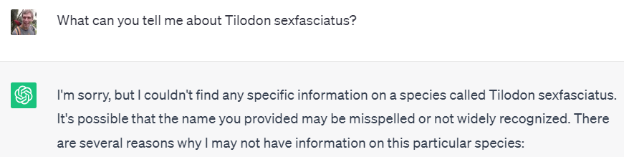
Early failures
ChatGPT 4: usually doesn’t know. But at least it’s not faking!
OceanOmics

Slide 9
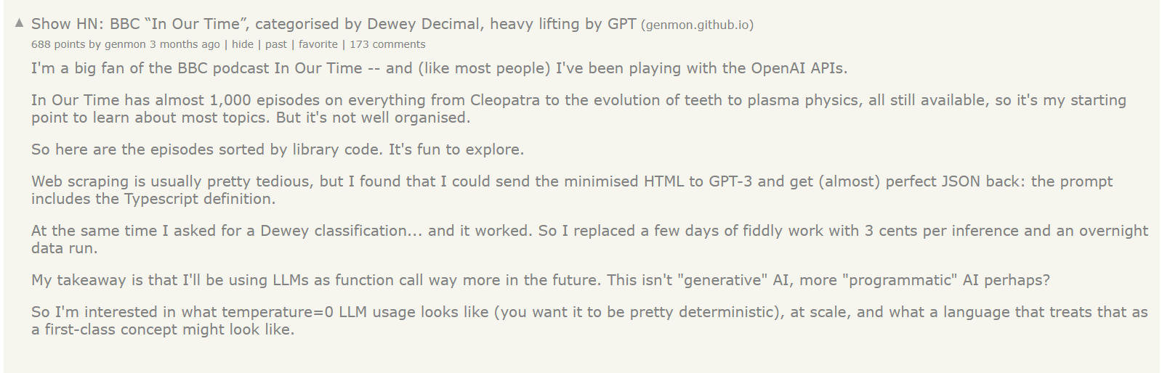
Then this came out: main inspiration
OceanOmics

Slide 10
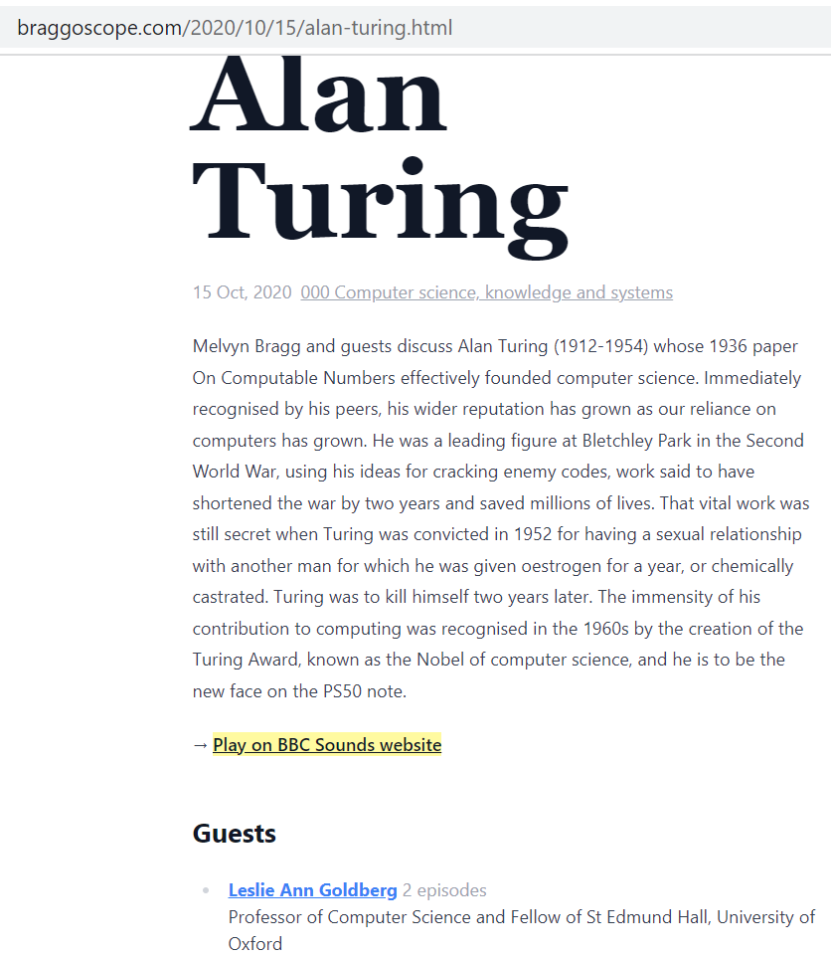
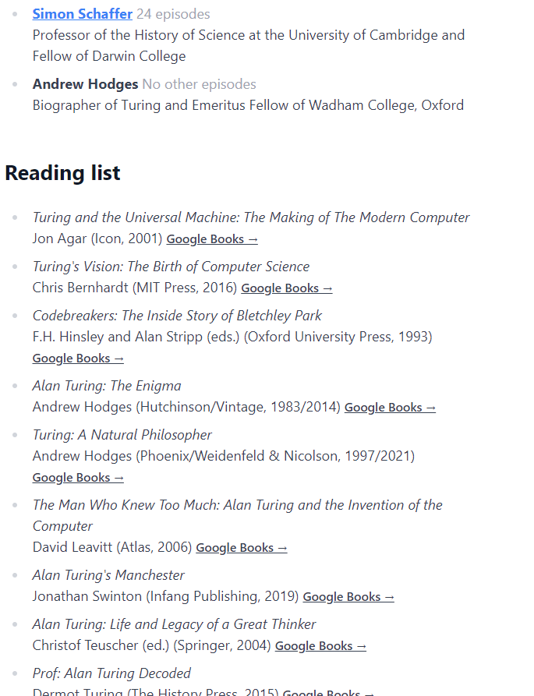
MAIN INSPIRATION for this work
OceanOmics
Notes:
This is one of the results for one episode. Summary of the text, guest list, reading list generated by ChatGPT based on the transcript of the recording.

Slide 11
OceanGPT version 1
Similar to Braggoscope: I wrote an R-script that turns all of our species sightings into one huge blob of fake English text.
Example: Planiliza alata was observed in sample 15 on the 24th of September, 2022, at latitude X and longitude Y.
LOTS of text like that
OceanOmics

Slide 12
OceanGPT version 1
Built using langchain!! An amazing library that lets you connect all kinds of LLMs around various tasks.
It’s using OpenAI ChatGPT, but it’s not too hard to replace the LLM used:
llm_chain = LLMChain(llm=OpenAI(temperature=0), prompt=prompt)
OceanOmics

Slide 13
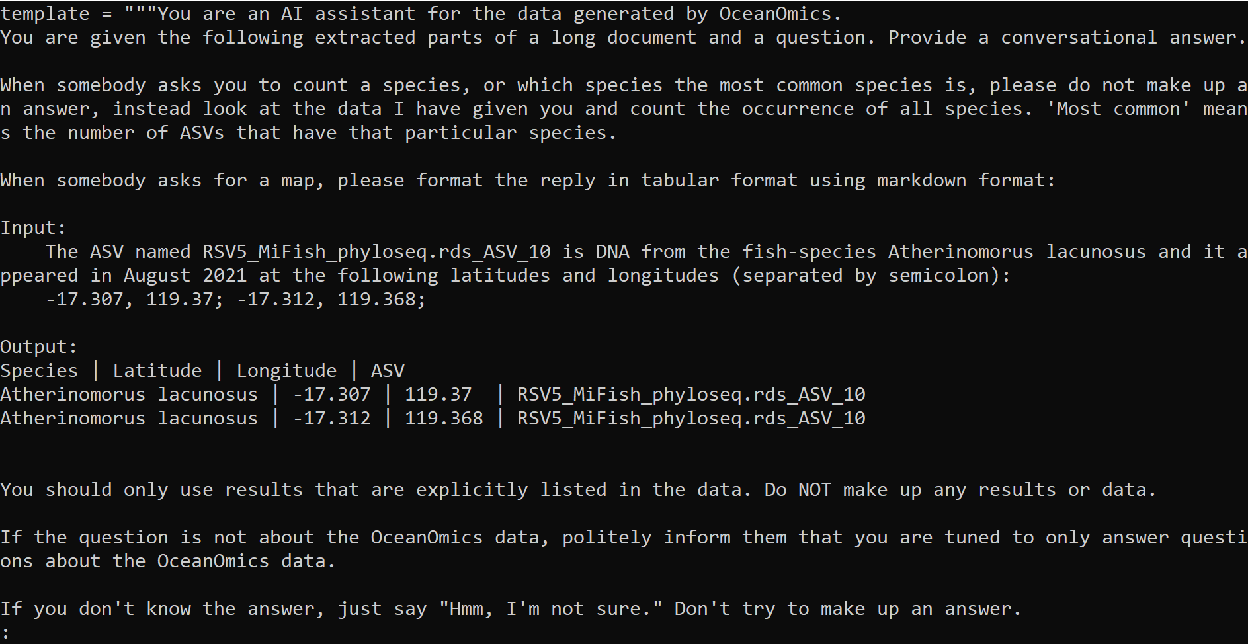
OceanGPT version 1
OceanOmics
Notes:
Below this is the huge blob of sightings text

Slide 14
OceanGPT version 1
That did not work. My ‘fake’ text exceeded the token limit of chatgpt-3.5.
Any clever workarounds of chunking the text resulted in inaccurate results: Question ‘how often does species X appear’ would undercount.
New chatgpt-3.5 16k context version could have helped, but that one came out just 13.6.2023
I abandoned this structure for a different way of looking at the problem
OceanOmics

Slide 15
OceanGPT version 2
I switched to langchain’s AgentExecutors that have several Tools. Code is written by GPT, the computer runs the code, the results of that code are returned to the user.
Downsides: less ‘imaginative’.
Upsides: FAR more trustworthy!! You get the code results, not the hallucination.
OceanOmics

Slide 16
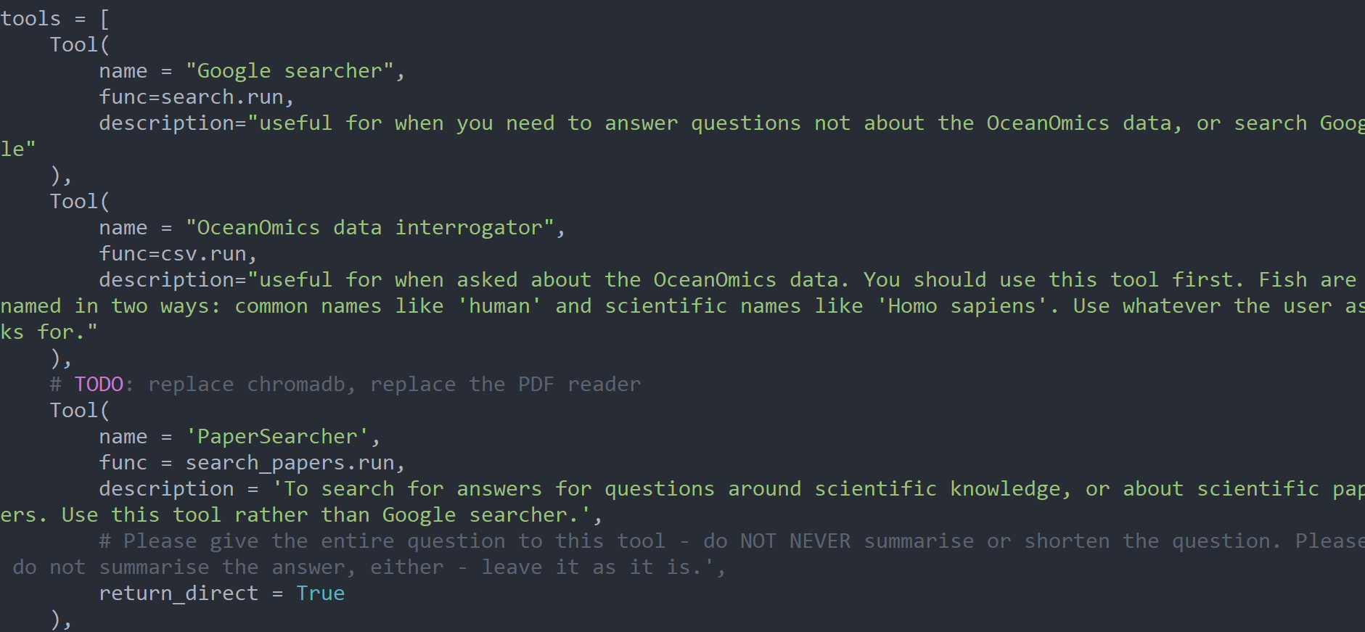
OceanGPT version 2
OceanOmics

Slide 17
OceanGPT version 3
Downsides:
Sometimes, it hallucinates tool-names.
Some tools don’t know much about the data they’re looking at.
It’s very hard for users to see what’s going on.
So I added Chain of Thought (CoT) (again via langchain) (Wei et al., 2022)
A specific set of prompts that gets ChatGPT to tell you what it’s doing as it goes along.
OceanOmics

Slide 18
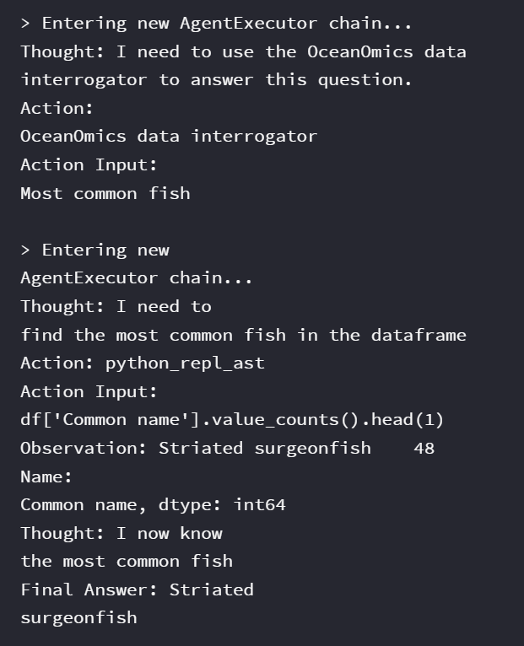
OceanOmics

Slide 19
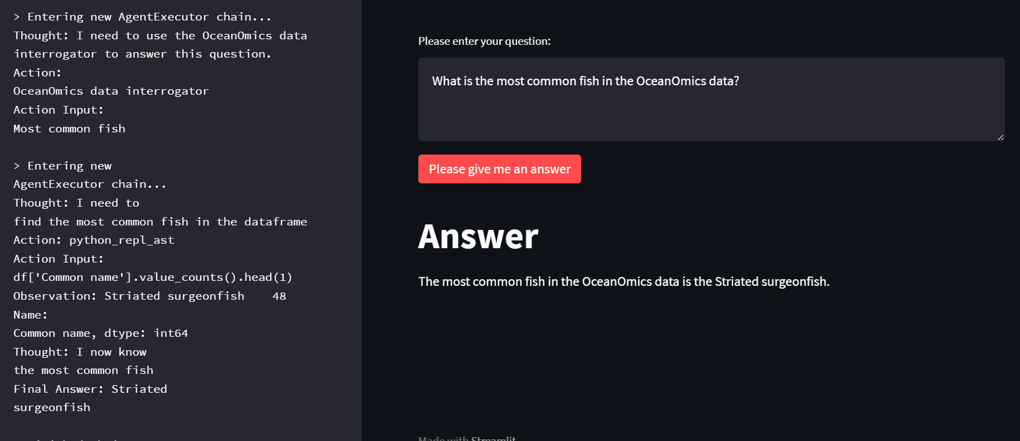
OceanGPT version 3
OceanOmics
Notes:
Here you can see most of the main page – you can see the question, the final answer, and the Chain of Thought that got us there.

Slide 20
OceanGPT version 3
And that’s where I’m currently at!! It now can:
Write (simple) Python code on our data results and calculate (mostly) correct results
Use ChromaDB (papers-qa style) to answer questions about PDFs of eDNA papers
Classify DNA when a user enters DNA (-> species label)
Ask Google for ‘mostly correct’ answers via SerpAPI
OceanOmics

Slide 21
OceanGPT version 3
What I’m looking at now:
Replace Python (pandas) agent by SQL agent.
Tree of thought (Yao et al 2023). Evaluates several answers, pulls out the best ‘way forward’. Not in langchain yet (but several PRs and issues open)
A 2nd LLM evaluating security of code generated before running
Some quality improvements; code that does more exciting things with the GPT output. Draw maps, link into other databases etc.
Locally run open source LLMs (FALCON?). Finetune own GPTs.
How to best deploy all this in a reasonably safe and cost-effective manner
OceanOmics

Slide 22
OCEANGPT, current status
With the ocean data project, I don’t have as many ethical problems as a human-centric application.
Currently the answers are best for the ‘vibe’ (Vicki Boykis), the model gives you the general direction you yourself can go into. But: do users agree? They might not proceed.
It’s not deployed publicly (yet). Python agent terrifies me (unchecked code on my system!!), internal document pipelines ‘security’/’reputational’ risks
OceanOmics
Notes:
It’s unlikely that I trigger department closure, for example, or send someone to prison.

Slide 23
OCEANGPT, current status
BUT: what if a wrong OceanGPT answer leads to a proposed marine park NOT getting established, where it should’ve been established? Who is responsible, who is accountable? Would people even realise the error?
Even if a person says they’re not including OceanGPT answers, they might still get influenced by the answer! see ‘nudging’, ‘priming’ (controversial in themselves)
Marine park establishment is surprisingly political and emotional. What if a MPA opponent uses OceanGPT to embarrass the organization? Potential quote: ‘How can you trust their science if their tech lies to your face?’
OceanOmics

Slide 24
OCEANGPT, other threats
Malicious actors:
Could use the tech to track endangered or highly valuable fish
Malicious prompting could get used to have GPT produce opposing messages with no data support (‘don’t establish this marine protected area!’)
OceanOmics

Slide 25
OCEANGPT, current status
The biggest problems:
I cannot trust the output 100 percent.
The way GPTs/LLMs are currently trained means we will never get to 100% truth. Truth is not an objective.
Not possible to predict when it goes off-track. Easy task, hard task, equally likely problematic? (see: self-driving cars)
OceanOmics

Slide 26
Will GPTs/LLMS PUT you out of a job?
I don’t know, maybe???
Depends on how dodgy your bosses are! Biggest amount of ‘money saved by LLMs’ is in LLM-based customer support, but it’s a worse product. (examples: eating disorder chat; doordash support)
-> Doctorow’s ‘enshittification’!
Are your bosses OK with an inferior product? Then yeah, your job is threatened, even if the LLM does an obviously worse job than you! It’s cheaper than you!
OceanOmics
Notes:
Doordash: not understanding yeeted food!

Slide 27
what are current GPTs/LLMs good for? (IMHO)
Are you ok with < 100% correct answer? Good for story bots, chat bots, joke bots, fake test data generation etc.
Partner-in-writing: editing text for clarity, for structure (-> manubot-ai-editor)
Do you have large amounts of unstructured text that you’d like to get into a structured format? This is the killer feature of GPTs/LLMs to me.
That does not align with the hype in the press and AI community ☺
OceanOmics
Notes:
. Take gigabytes of free-form text, chunk into pieces, send to ChatGPT with prompt, get JSON structure back. We’re drowning in piles of unstructured valuable data nobody can evaluate at scale. (-> earlier Braggoscope example!)
3) Not enough doom. Good, because boring progress. I don’t see any AGI.

Slide 28
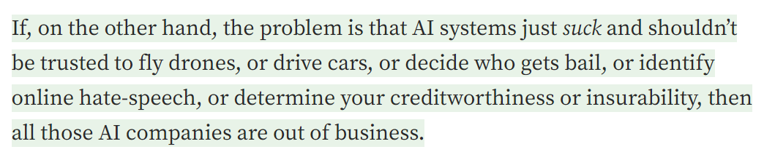
SO Why the hype?
- Cory Doctorow, https://doctorow.medium.com/ayyyyyy-eyeeeee-4ac92fa2eed
OceanOmics

Slide 29
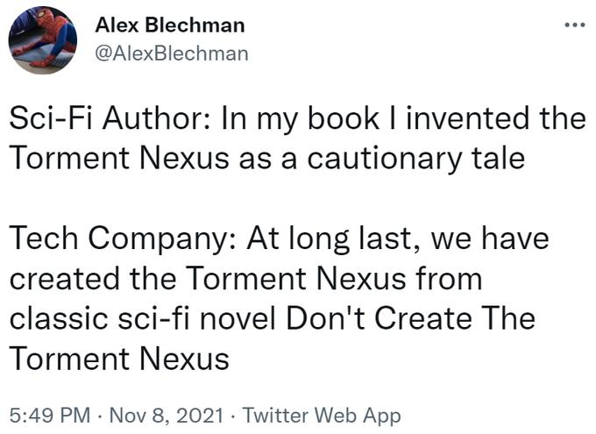
Closing words: YOU DON’t HAVE TO BUILD THE TORMENT NEXUS
OceanOmics
Notes:
You are in a unique position as (currently) only you can build the Torment Nexus. Only YOU can prevent things going worse.

Slide 30
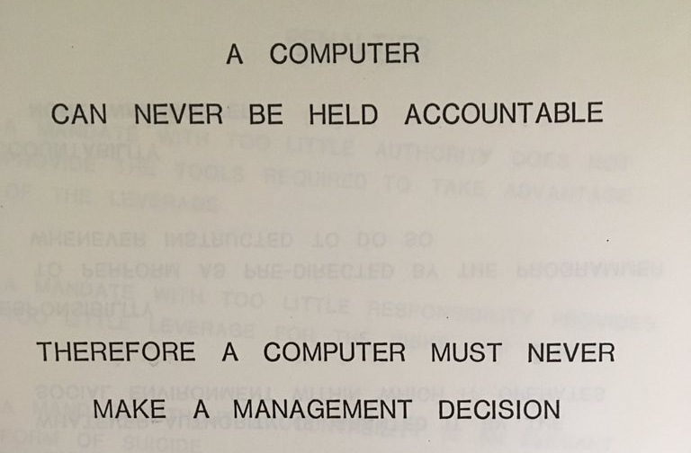
OceanOmics
Notes:
IBM training notes, 1975

Slide 31
QUESTIONS?
Also hiring AI RA soon! -> pbayer@minderoo.org
minderoo.org
PO Box 3155, Broadway Nedlands, Western Australia 6009
hello@minderoo.org +61 8 6460 4949

